Slide 1
New England Educational Opportunity Association

Slide 2
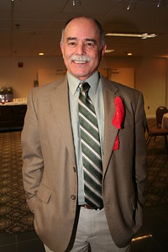
The Mission of NEOA is
to advocate for access to and success in postsecondary education for low-income individuals, first generation college students, and students with disabilities and to develop the skills and knowledge of educational opportunity professionals working with this population.

Slide 3
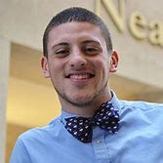
Alumni Committee
- Randy Schroeder
COE Board Alumni Chair Justice Lopez planned on
attending our Conference
Helped to Plan 2020 Alumni Policy Seminar Dinner
The NEOA Achiever from UNH has agreed to be nominated
for the National TRIO Achiever Award announced at the
COE Annual Conference in San Antonio during SEPT. 20-23, 2020.
2012 NEOA Achiever Enid Rey agreed to be a reader for this year’s
Achiever nominees.
With the support of the TRIO Day 2020 Committee, organized the college fair in Framingham, MA. A total of 49 schools participated. In follow up, several admissions representatives had great praise for the excellent engagement of TRIO students and constructive feedback for the organization of the Fair and for the students participating.
Participated in the virtual COE Policy Seminar on March 24.

Slide 4
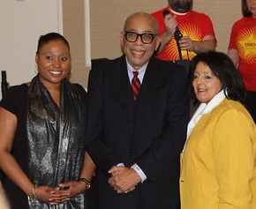
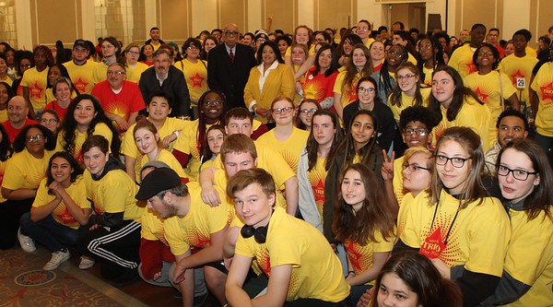
2020 TRIO Day Celebration
- Mona Savastano and Samienta Pierre-Vil
Dr. Arnold Mitchem was the Guest Speaker and stated that this is the Biggest TRIO Day Event in the Country! 522 Students Attended TRIO Day 2020 and congratulated NEOA and the students!
A Total of 618 participants
522 Students from
47 programs
96 Staff Attended
49 Colleges Attended
the College Fair
17 College Tours

Slide 5
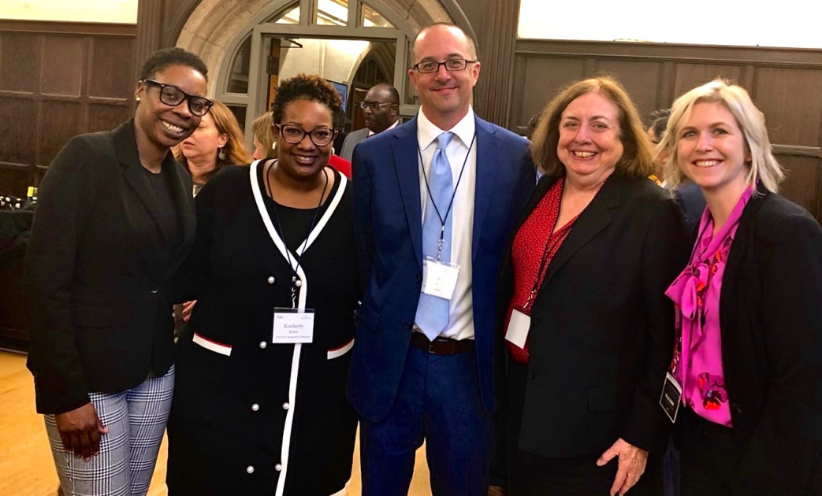
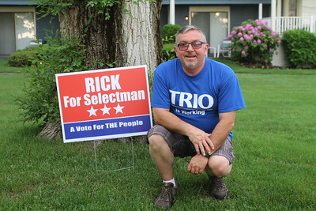
Development Committee
- Reggie Jean and Raymond Gonzales
ASA has donated at the Masters level with $10,000 contribution to support NEOA Activities for this year!
Mastery Prep gave an additional $1000 to support alums attending the National Policy Seminar and will allow us to use it for next year.
The NEOA Auction will go Live April 8th!
Please support our organization!

Slide 6
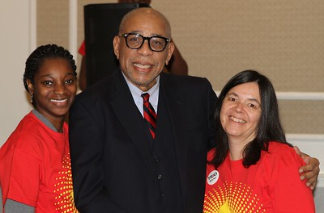
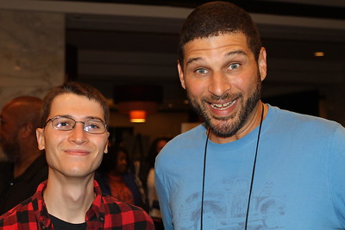
Diversity, Equity and Inclusion
- Steve Visco
Sent out a survey to the Membership.
The survey is inquiring further about how people
view DEI within our association currently.
The Committee has been working with
Luckson Omoaregba and had some great input.
Explored the possibility of Affinity Groups.
Soren is interested in potentially running a
workshop at a future conference and is
also writing a piece for the newsletter.
A Bias Statement is definitely a priority of ours.
The Committee does not want to rush it
- this topic deserves more time and thought.

Slide 7
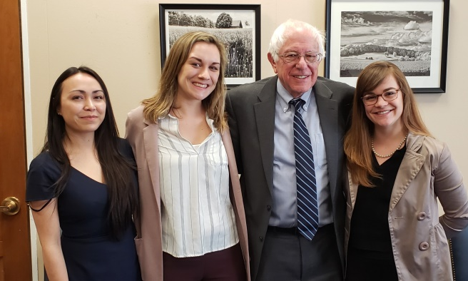
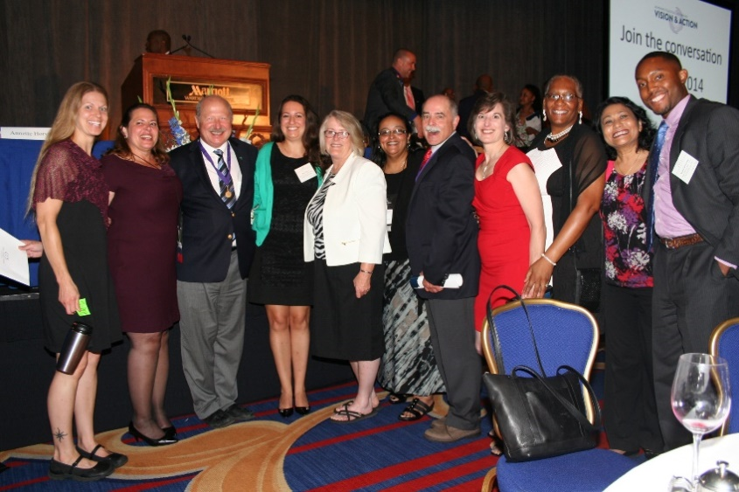
Legislation and Education
-Sarah Morrell
Worked closely to help state prepare for the
2020 Policy Seminar
Several people have submitted Updated State Booklets.
Casey has uploaded those new versions to the website. It is very important to have these updated and representation from every state, as we never know who could be accessing the site.
Recently joined the New England Council
- Higher Education Committee.
We have funded 1 State Initiative and
are evaluating 2 others!

Slide 8
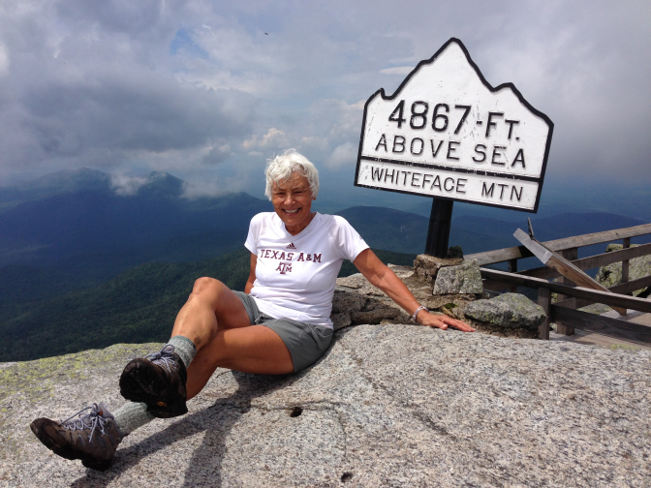
Elaine Leavitt Committees
Strategic Plan:
1) The Board committed to making the 5-Year Strategic Plan (2016-2021) a living document throughout the
year. continuously and effectively throughout this past year on addressing the goals laid out in the 5-Year Strategic Plan (2016-2021).
2) Purposeful attention was given to the Finance, Advocacy and Technology Committees to address desired enhancements in meeting their goals. Quarterly benchmarks were set and fulfilled.
3) Quarterly and on-going benchmarks for all positions and committees were monitored in preparation for evaluation at the June Board meeting.
Retirees:
1) Effects were made throughout the year to identify colleagues who were or are retiring in 2019-20.
2) The five (5) identified retirees were contacted, invited to be recognized in the Conference Program and encouraged to remain connected post-retirement.
3) The Retirees Spreadsheet was updated to include not only the new retirees but to update the individual states' retirees rosters.
Newsletter:
1) Submitted a survey to NEOA membership to assess what they
would most like in the newsletter (120 responses).
2) Researched, prepared and submitted 3 issues to membership
since the last Annual Meeting.
3) Coordinated with Public Relations Committee to have newsletters
available through various social media forums.

Slide 9
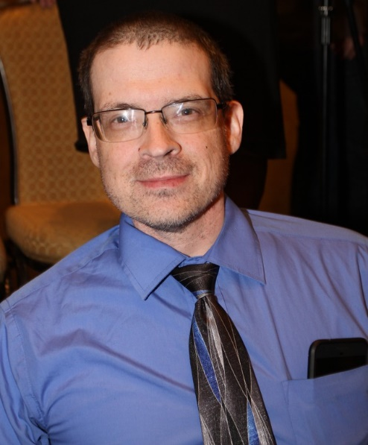
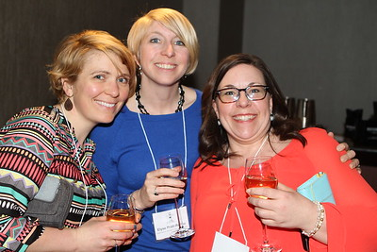
Technology Committee
-Casey Henderson:
Set a new BOX Drive Account for the NEOA Board
Worked more closely with the State Liaisons to support the technology needs of the association
Transferred the Website to a new more accessible and user friendly format
Served on the conference planning committee and assisted with a variety of technology arrangements and website updates
After the conference was cancelled, I provided advice and assistance with making alternative arrangements for the board meeting and business meeting and elections

Slide 10
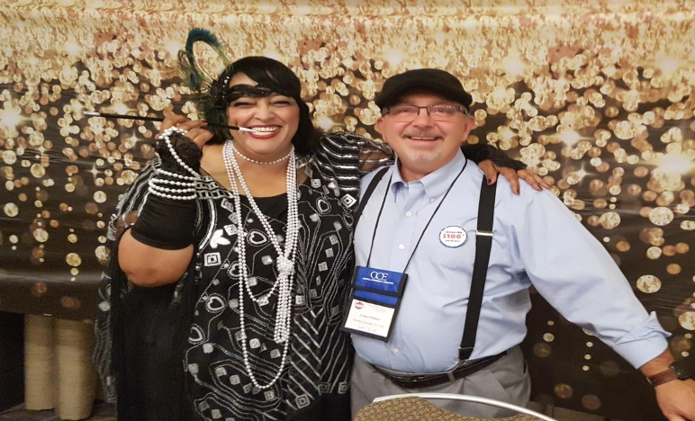
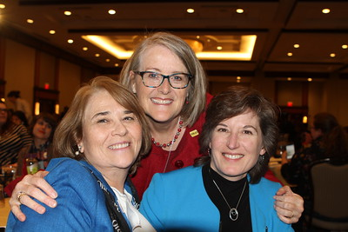
Public Relations Committee
-Tony Staffiere
Many States have been great at forwarding
or tagging NEOA platforms when they post information specific to their programs.
In this unprecedented time of leading virtually,
this should be a priority moving forward.
Serve as a bridge between NEOA member states and COE efforts in Washington, D.C. I will make connections with the person responsible for external ops at COE.
#TRIODay2020 was a big success and got a lot of traction with our membership through the region. Social media platforms continue to lead the charge in this area.

Slide 11
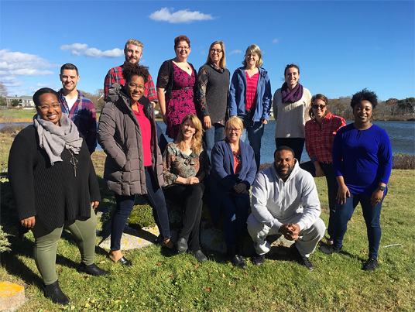
The 2020 – 2021 NEOA
Arnold L. Mitchem Leadership Institute
2018 AMLI had 13 participants
who met 4 times
The NEOA Board has contracted
Craig Werth to Direct the
2020 – 2021 Leadership Institute
Applications and Information
will be shared with the Membership in May 2021
Craig hopes to have 16 participants for this outstanding Professional Development Opportunity

Slide 12
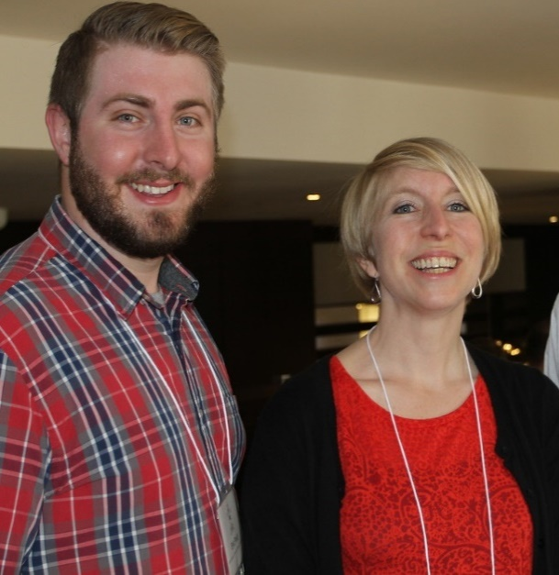
NEOA Achievers Committee
-Elyse Pratt - Ronco
We received 9 nominations this year
(3 Achievers and 6 Rising Stars)
Selected Readers from Across New England
Our readers selected 2 recipients for each award
Recipients all planned to attend the
Awards Luncheon
The NEOA Board is looking into the
best way to honor these 2020 Achievers.

Slide 13
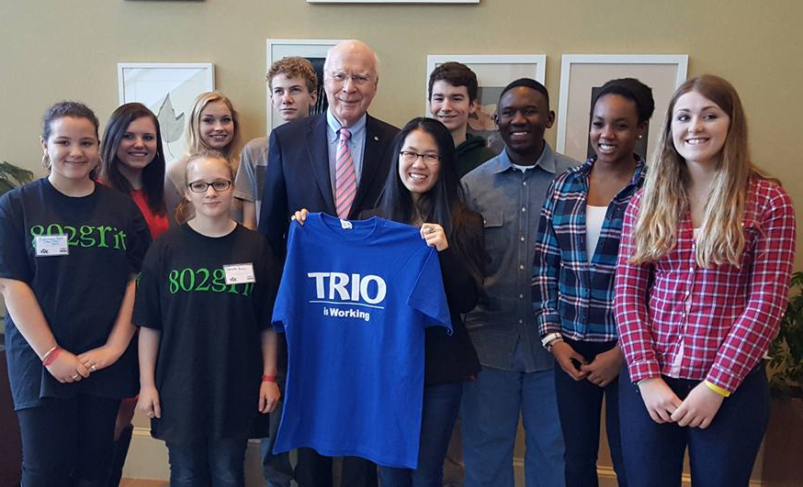
Professional Development
Committee - Lynn Ploof-Davis
Professional Development Funds Awarded for the Following Events:
Leadership Institute Evaluation Weekend - October
EOC Annual Conference – November
COE Study Tour – November
SSS Grant Writing Workshop – January
TRIO Alumni Participation in the MEEOA/COE Sponsored Disparities in Education Plenary at the MEEOA annual conference.
Additionally, a professional development survey
was distributed to the membership in November.
The two largest areas of interest were
Best Practices and Budget Management
Given the vast amounts of professional
development currently taking place
spontaneously, plans are in the
works to create an NEOA Clearinghouse
where activities and best practices to
support students can be stored.
Notes:
In his State of the Union address in January, the President reminded us that we are not yet what we seek to be: a country that promises opportunity for all young people who are willing to work hard to seek it. Education is a vital part of that opportunity.
The President’s budget lays out a clear set of priorities that aim to establish far greater equity of opportunity.

Slide 14
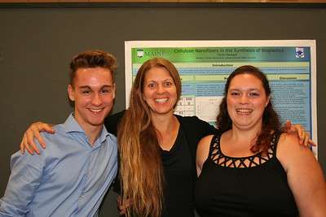
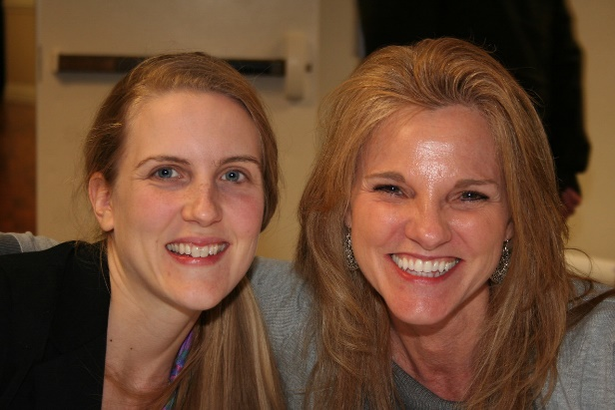
New England’s Fair Share
Fair Share is COE’s Annual Giving Campaign
About half of COE’s annual budget comes from Fair Share in the amount of $3,506,000.
Fair Share is based on Institutional Membership Dues and Personal Contributions
NEOA’s Fair Share Goal is $188,910 – we are at 56% of our Goal!
Please consider contributing to support COE as they help us prepare
for the next few months and beyond!

Slide 15
New England Educational Opportunity Association
2019 – 2020 Board of Directors

